Slide 1
MORIYM BEGUM
ASSISTANT TEACHET
DARICHAR PRIMARY GOVT . SCHOOL
HOMNA .COMILLA

Slide 2
CLASS ; TWO SUBJECT . ENGLISH

Slide 3
Learning out come; The students able to listen and say correctily

Slide 4
EMOSTION GROW ; Saying a rhyme

Slide 5
LESSON TITLE ; PARTS OF THE BODY

Slide 6
Presentation:
Tacher loud reading.
Students will say with me.

Slide 7
Tuch your head
Tuch your nose
Tuch your eye
Tuchyour ear
Tuch your mouth
Tuch your shoulder

Slide 8
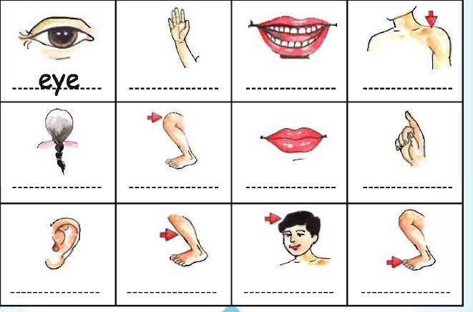
Head
Mouth
Ear
Eye
Hand

Slide 9
Evaiuation
What ‘s this?
What’s this?
What’s this?
What’s this ?
What’s this ?

Slide 10

THANKS EVERY BODY

